Slide 1
Travelling Salesman Problem
Problem Statement:
The traveling salesman problem consists of a salesman and a set of cities. The salesman has to visit each one of the cities starting from a certain one (e.g. the hometown) and returning to the same city. The challenge of the problem is that the traveling salesman wants to minimize the total length of the trip.

Slide 2
Naïve or Brute force Approach
In this approach we will try all combinations and find the minimum cost path (tour).
This requires factorial time complexity
It is not trivial as the number of cities more.

Slide 3
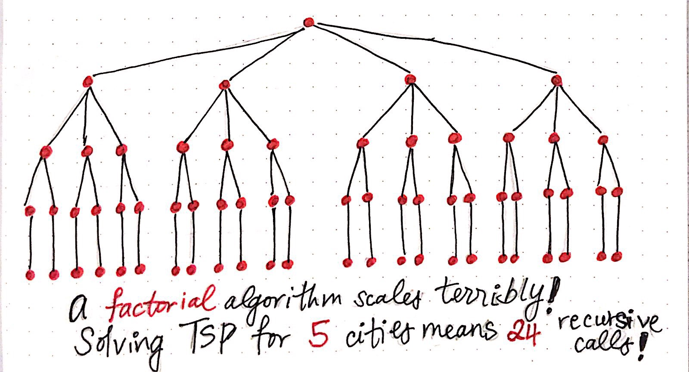

Slide 4
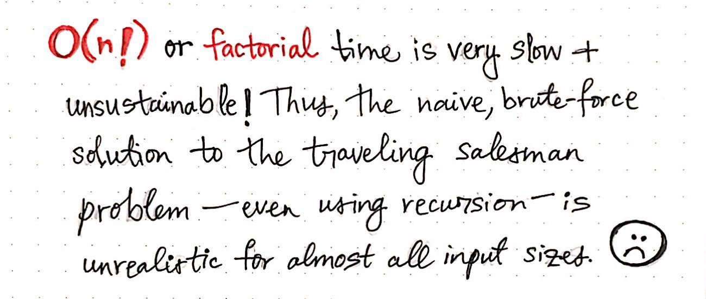

Slide 5
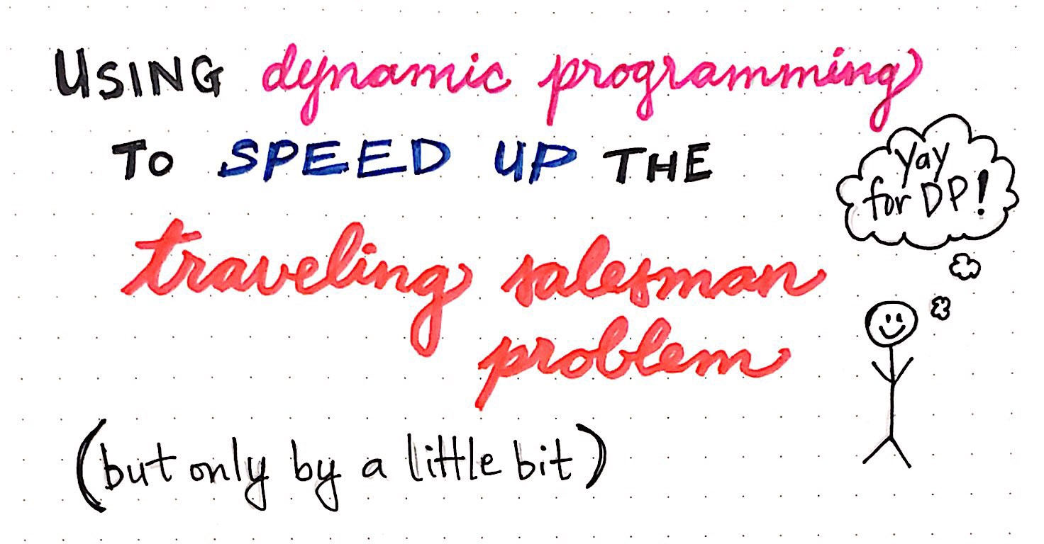

Slide 6
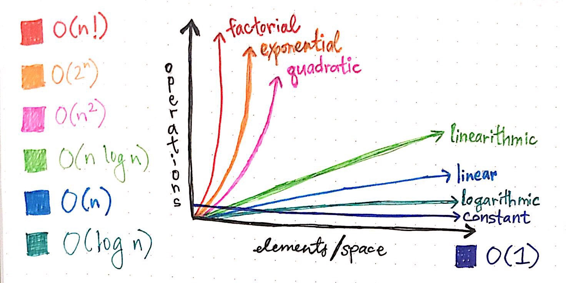

Slide 7
TSP using Dynamic Programming Approach
Step 1: Assume any vertex as start vertex
Step 2: Compute the power set called Via-Set using remaining vertexes (remove start vertex)
Step 3: Select every subset from Via-Set and compute the cost from start vertex to every un visited vertex via Via-Set vertices.
Cost(I,j) Via-Set
i------→ destination vertex number
J -----→ vertex from via-set

Slide 8
TSP using Dynamic Programming Approach
Step 4: Fill up the following table
Via-Set
Cost
d

Slide 9
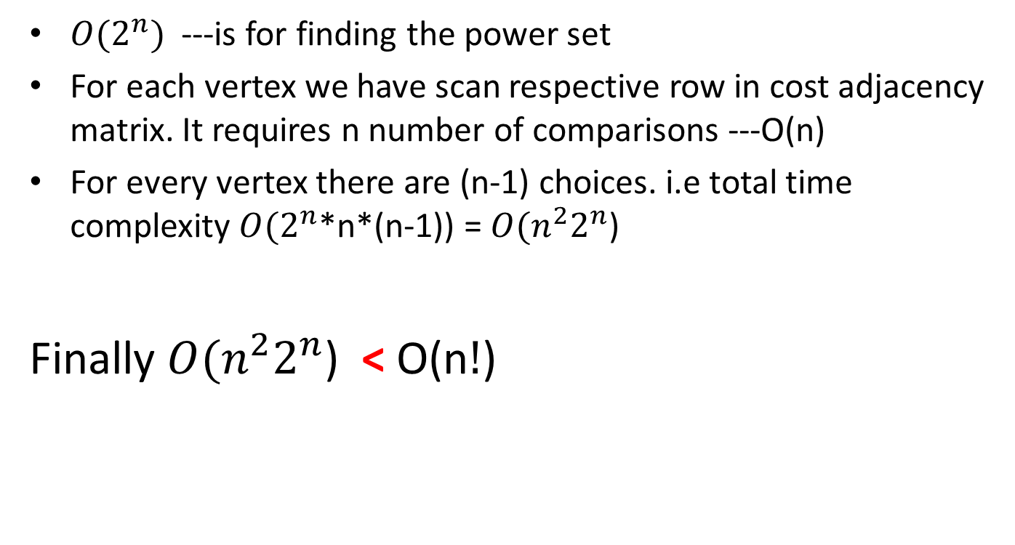
Time Complexity Analysis of DP Approach
${O(2}^{n})$ ---is for finding the power set
For each vertex we have scan respective row in cost adjacency matrix. It requires n number of comparisons ---O(n)
For every vertex there are (n-1) choices. i.e total time complexity ${O(2}^{n}$*n*(n-1)) = ${O(n}^{2}2^{n}$)
Finally ${O(n}^{2}2^{n}$) < O(n$!$)

Slide 10

Example:
$\begin{matrix}0 & 1 & 15 \\ 2 & 0 & 7 \\ 9 & 6 & 0\end{matrix}\begin{matrix}6 \\ 3 \\ 12\end{matrix}$
10 4 8 0

Slide 11
Useful Links
https://www.youtube.com/watch?v=-JjA4BLQyqE&t=140s

